Slide 1
MSE – 803 – Data Analytics
Week 11 – Activity 1
Airline Pipeline
Andre Benedetti
28/06/2026

Slide 2
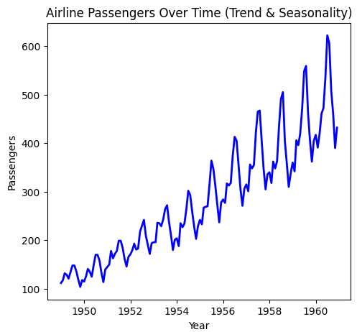
Airline Pipeline Dataset and Project Objectives
The dataset:
44 monthly observations over 12 year of the numbers of passangers of na Airline.
No missing data or outiline was observerd.
Project Objective:
Predict future passengers using variable models – ANN, ARIMA, Linear Regression, LSTM, XGBoost
Evaluate the used models – RMSE, MAE, R², MAPE

Slide 3
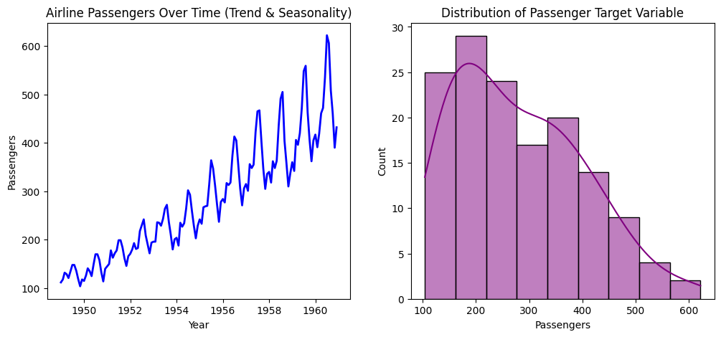
Airline Pipeline – EDA Distribution and Seasonnality

Slide 4

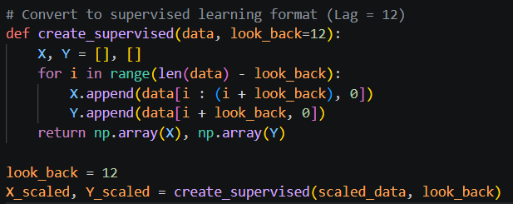
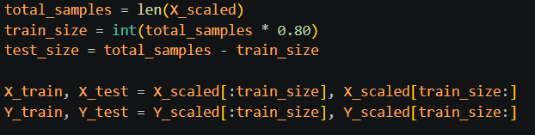
Airline Pipeline Engineering and data preparation
Scale passenger data to a value between 0 and 1 to ensures stable, faster training and prevents features with larger magnitudes from dominating the loss function.
Applying a 12 months sliding windown so the machine learning learning can capture the annual seasonality
Split the data set into train values (80%) and test values (20%)

Slide 5

Airline Pipeline Engineering and data preparation - ARIMA
As ARIMA models works better with unscale data and a continuos dataset as the index, the original dataset is copied and the “Month” column is set as index.
Adding look_back (12) here ensures that ARIMA trains and tests on the exact same calendar months as the other models.

Slide 6
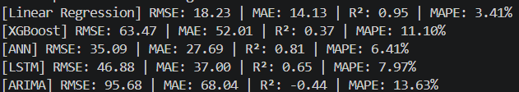
Airline Pipeline Models Comparisson
RMSE - Root Mean Squared Error: It mesures the avegare distance between the model prediction and the actual values, penalizing larger mistakes heavily.
MAE - Mean Absolute Error: It measures the average absolute magnitude of the errors.
R² - R-Squared / Coefficient of Determination: It tells you how well your model fits the overall shape and trend of the data compared to a simple horizontal line representing the average.
MAPE - Mean Absolute Percentage Error: It measures the average error as a percentage of the actual values.

Slide 7
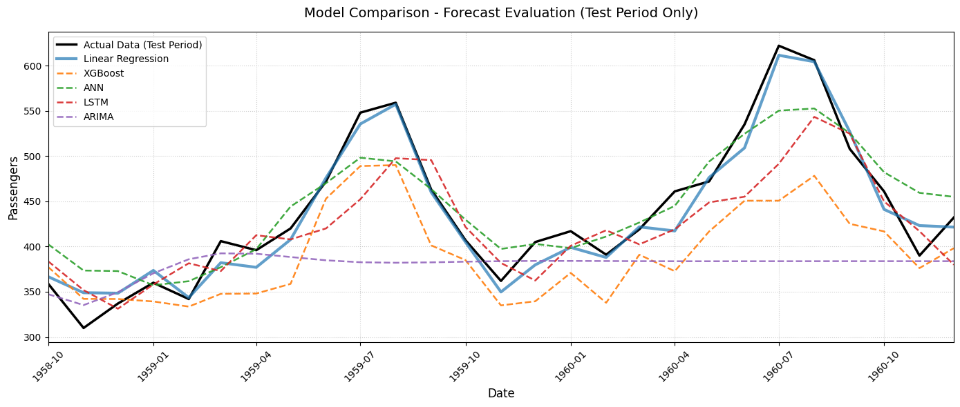
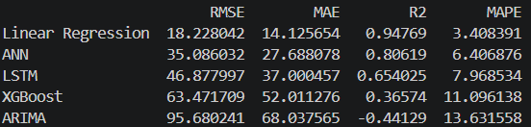
Airline Pipeline Models Comparisson
Linear regression shows the best result with a MAPE of only 3.4%, on average, the model’s prediction are off only by 3.4%. Its R² of 0.95 indicates that it explain 95% of the variance in the test data.

Slide 8
Airline Pipeline Models Strenghts and Limitations
 | Strengths | Limitations
Linear Regression | Exceptional performance on this specific dataset (R² = 0.95, MAPE = 3.41%). It acts as an optimal baseline because the airline-passengers dataset exhibits a dominant, unbroken linear growth trend over time. | Highly rigid. It assumes the structural trend will never slow down, shift, or crash. It is incapable of capturing complex non-linear shocks.
Artificial Neural Network (ANN) | Good predictive accuracy (MAPE = 6.41%). It managed to approximate both the upward trend and the repeating seasonal cycles reasonably well through its hidden layers. | Black-box nature makes it harder to interpret than standard regression. It requires explicit tuning of architecture and learning rates to prevent overfitting.
Long Short-Term Memory (LSTM) | Designed specifically for sequential architecture. It excels at retaining long-term dependencies across time windows natively. | LSTMs typically require thousands of rows to accurately map weights. With only 144 data points, the network likely overfitted the training patterns, leading to degraded test metrics (MAPE = 7.97%).
XGBoost | Highly efficient, handles tabular structures beautifully, and immune to outliers. | Fatal architectural flaw for trending data. Tree-based ensembles predict by splitting data into hard-capped leaves. Consequently, XGBoost cannot extrapolate target values higher than the maximum value it observed during training. On an upward-trending timeline, it effectively "flatlines" at the training ceiling.
ARIMA | Computationally lightweight statistical baseline that forces mathematical rigor regarding data stationarity. | Horrible performance here (R² = -0.44, MAPE = 13.63%) because a standard ARIMA(2,1,1) lacks a seasonal component. It completely missed the massive annual spikes and troughs of the aviation industry.

Slide 9
Airline Pipeline Data insight
Passenger volume grows continuously year-over-year. The data never returns to its historical average; every year establishes a brand-new baseline. This is why Linear Regression dominated (R² = 0.95). The trend is so dominant that simply drawing a straight line into the future captures the vast majority of the data's variance. Conversely, this is why XGBoost failed miserably—it can only predict within the boundaries of what it has already seen, making it blind to a continuous upward trajectory.
The dataset has a strict 12-month cyclical pattern (summer peaks, winter troughs). Crucially, the variance of these peaks and valleys increases as the trend increases. The gaps between the highs and lows get wider every single year. Because the seasonal swings are magnifying over time, a standard linear model or a basic ARIMA(2,1,1) model (which assumes constant variance over time) falls short on the exact peaks. To perfectly map this data, a model must understand that the seasonal impact is a percentage multiplier of the trend, not just a fixed number of passengers added each July.

Slide 10
Airline Pipeline Recommendations
Dynamic Pricing: The dataset reveals an aggressive, highly predictable annual cycle with massive demand spikes during summer holiday periods and steep troughs in winter. The airline should deploy predictive dynamic pricing engines that aggressively raise fare classes months in advance for peak periods while using targeted promotions to stabilize low-utilization winter windows.
Fleet & Crew Management: The expanding variance over time shows that the gap between peak summer demand and low winter demand is widening significantly every single year. To optimize resources, the airline must schedule heavy aircraft maintenance and crew training blocks strictly during predictable winter troughs while utilizing flexible short-term leasing to absorb summer peaks.
Preemptive Infrastructure Scaling: The continuous, compounding linear trend proves that the aviation market is expanding structurally rather than experiencing temporary fluctuations. Executive leadership must use this clear trajectory to preemptively secure future airport slots, expand ground-handling partnerships, and sign multi-year aircraft procurement contracts

